Slide 1


Raúl Alfonso
05-01-25

Slide 2

Outline
Executive Summary
Introduction
Methodology
Results
Conclusion
Appendix

Slide 3
Executive Summary
The IBM Data Science Capstone Project showcases the application of data science methodologies to solve a real-world problem, and it is developed in order to strengthen the knowledge acquired during the course.
Methodology
The project follows a comprehensive data science lifecycle, including:
Problem Definition
Data Collection and Cleaning
Exploratory Data Analysis (EDA)
Model Development
Visualization and Communication

Slide 4
Executive Summary
Results
The project delivers the following outcomes:
Key Insights: Identification of the most influential factors affecting launch success, such as budget thresholds or specific rocket models.
Predictive Model: A model capable of forecasting the probability of success for future launches based on the provided data.
Actionable Recommendations: Strategies to optimize resource allocation and improve launch success rates, such as investing in specific launch sites or models.

Slide 5
Introduction
Rocket launches are inherently expensive endeavors, making cost optimization a critical focus for the aerospace industry.
A significant portion of the costs can be mitigated by successfully recovering parts of the rocket after launch.
However, achieving this recovery depends on various factors such as the number of previous launches, the allocated budget, the rocket model, and the launch site.
The primary objective of this project is to analyze historical rocket launch data to identify the key factors that influence the successful recovery of rocket components, ultimately enabling more cost-effective and sustainable space exploration.

Slide 6

Section 1

Slide 7
Methodology
Executive Summary
Data collection methodology:
Web scrapping and APIs where used in order to undertake this point.
Perform data wrangling
With python, some dataframes were created in order to organize data.
Perform exploratory data analysis (EDA) using visualization and SQL
Perform interactive visual analytics using Folium and Plotly Dash
Perform predictive analysis using classification models
How to build, tune, evaluate classification models

Slide 8
Data Collection
Using webscrapping and python, the data was collected from internet, specifically the library “BeautifulSoup”, “Requests” and “Pandas” were used.

Slide 9
Data Collection – SpaceX API
Present your data collection with SpaceX REST calls using key phrases and flowcharts
Add the GitHub URL of the completed SpaceX API calls notebook (must include completed code cell and outcome cell), as an external reference and peer-review purpose
https://github.com/raablb/finalProject/blob/13dc1101aa2423a232be0c89c0482dce376fe2b4/jupyter-labs-spacex-data-collection-api.ipynb

Slide 10
Data Collection - Scraping
Present your web scraping process using key phrases and flowcharts
Add the GitHub URL of the completed web scraping notebook, as an external reference and peer-review purpose
https://github.com/raablb/finalProject/blob/13dc1101aa2423a232be0c89c0482dce376fe2b4/jupyter-labs-webscraping.ipynb

Slide 11
Data Wrangling
In this part we calculated the number of launches of each site.
Calculated the number and occurrence of each orbit.
Calculated the number and occurence of mission outcome of the orbits
Created a landing outcome label from Outcome column
https://github.com/raablb/finalProject/blob/13dc1101aa2423a232be0c89c0482dce376fe2b4/labs-jupyter-spacex-Data%20wrangling.ipynb

Slide 12
EDA with Data Visualization
We prepared scatter plots of:
The relationship between Flight Number and Launch Site
The relationship between Payload Mass and Launch Site
We visualized the relationship between success rate of each orbit type
We prepared a bar chart of:
The relationship between FlightNumber and Orbit type
We prepared a line chart of:
We visualized the launch success yearly trend
https://github.com/raablb/finalProject/blob/13dc1101aa2423a232be0c89c0482dce376fe2b4/edadataviz.ipynb

Slide 13
EDA with SQL
%sql DROP TABLE IF EXISTS SPACEXTABLE;
%sql create table SPACEXTABLE as select * from SPACEXTBL where Date is not null
%sql SELECT DISTINCT Launch_Site from SPACEXTABLE
%sql SELECT * from SPACEXTbl WHERE Launch_Site LIKE 'CCA%' LIMIT 5
%sql SELECT SUM(PAYLOAD_MASS__KG_) AS TOTAL_PAYLOAD_MASS from SPACEXTABLE WHERE Customer = 'NASA (CRS)’
%sql SELECT min(Date) from spacextable where Mission_Outcome = 'Success' AND Landing_Outcome like '%ground%pad%’
%sql SELECT Booster_Version from spacextable where Mission_Outcome = 'Success' AND Landing_Outcome like '%drone%ship%' AND PAYLOAD_MASS__KG_ BETWEEN 4000 AND 6000
%sql SELECT mISSION_OUTCOME, COUNT(Mission_Outcome) from spacextable GROUP BY Mission_Outcome
%sql SELECT BOOSTER_VERSION FROM SPACEXTABLE WHERE PAYLOAD_MASS__KG_ IN (SELECT MAX(PAYLOAD_MASS__KG_) FROM SPACEXTABLE )
%sql SELECT CASE substr(Date, 6, 2) WHEN '01' THEN 'January' WHEN '02' THEN 'February' WHEN '03' THEN 'March' WHEN '04' THEN 'April' WHEN '05' THEN 'May' WHEN '06' THEN 'June' WHEN '07' THEN 'July' WHEN '08' THEN 'August' WHEN '09' THEN 'September' WHEN '10' THEN 'October' WHEN '11' THEN 'November' WHEN '12' THEN 'December' END AS month_name, landing_outcome, booster_version, launch_site FROM SPACEXTABLE WHERE substr(Date, 0, 5) = '2015' AND landing_outcome LIKE '%drone ship%’;
%%sql SELECT landing_outcome, COUNT(*) AS outcome_count,RANK() OVER (ORDER BY COUNT(*) DESC) AS rank FROM spacextable WHERE Date BETWEEN '2010-06-04' AND '2017-03-20’ GROUP BY landing_outcome ORDER BY outcome_count DESC;
https://github.com/raablb/finalProject/blob/13dc1101aa2423a232be0c89c0482dce376fe2b4/jupyter-labs-eda-sql-coursera_sqllite.ipynb

Slide 14
Build an Interactive Map with Folium
We added cicles to show where de launch sites were.
We also added pop ups to identify every launch site.
We also added lines to see the distance between launch sites and the coast.
https://github.com/raablb/finalProject/blob/13dc1101aa2423a232be0c89c0482dce376fe2b4/lab_jupyter_launch_site_location.ipynb

Slide 15
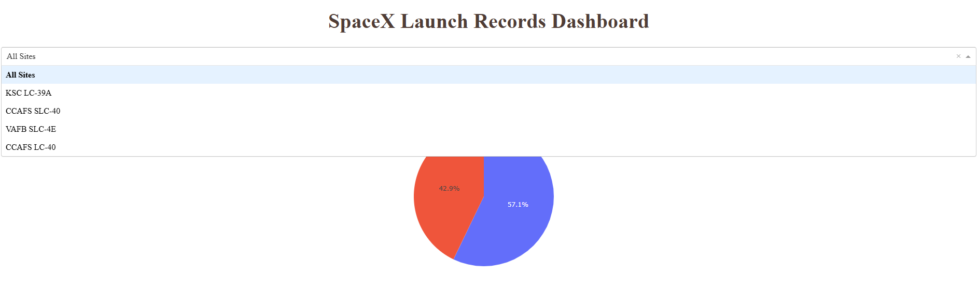
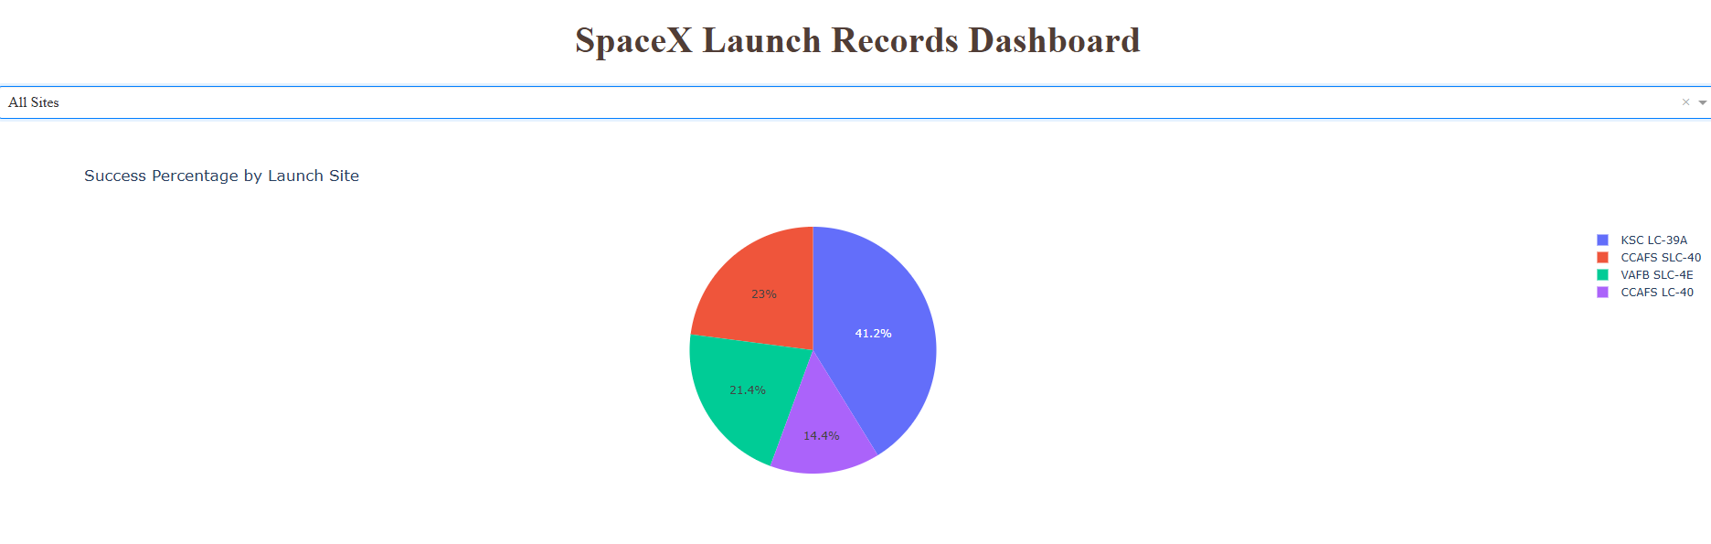

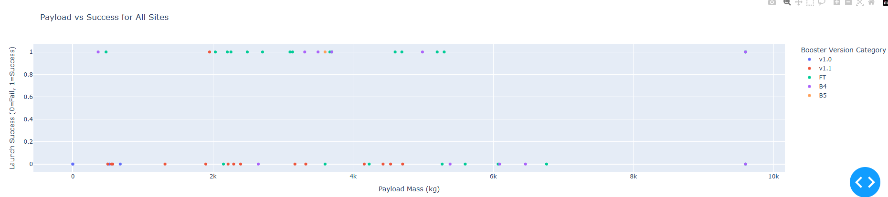
Build a Dashboard with Plotly Dash
https://github.com/raablb/finalProject/blob/6d77b8483c662a18b43c816e9a327f058246a64f/spacex%20dahs.py

Slide 16
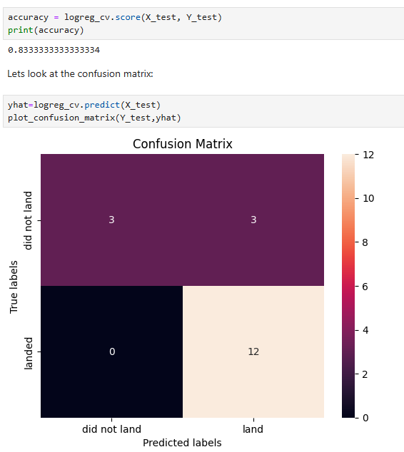
Predictive Analysis (Classification)
In this part we performed a predictive analysis, we used a logistic regression y calculated de accuracy, 0,83 y the confussion matrix.
https://github.com/raablb/finalProject/blob/65c657f0821e5a9092736b931869b374c27e1930/SpaceX_Machine%20Learning%20Prediction_Part_5.ipynb

Slide 17


